Slide 1
Development of a steering rack electric drive control system for an autonomous vehicle
Sokurov R., 8E02

Slide 2
Goals and objectives of the final paper
The goal of my final paper is development of a steering rack electric drive control system for an unmanned vehicle and its implementation on the steering rack electric drive control unit
Objectives of the final paper:
Examine the electric motor of the steering rack, determine its characteristics
To develop a simulation model of the electric steering rack drive
To develop a simulation model of the steering rack electric drive control system
Optimize the steering rack electric drive control system
To conduct an experimental study of the developed simulation model of the steering rack electric control system

Slide 3
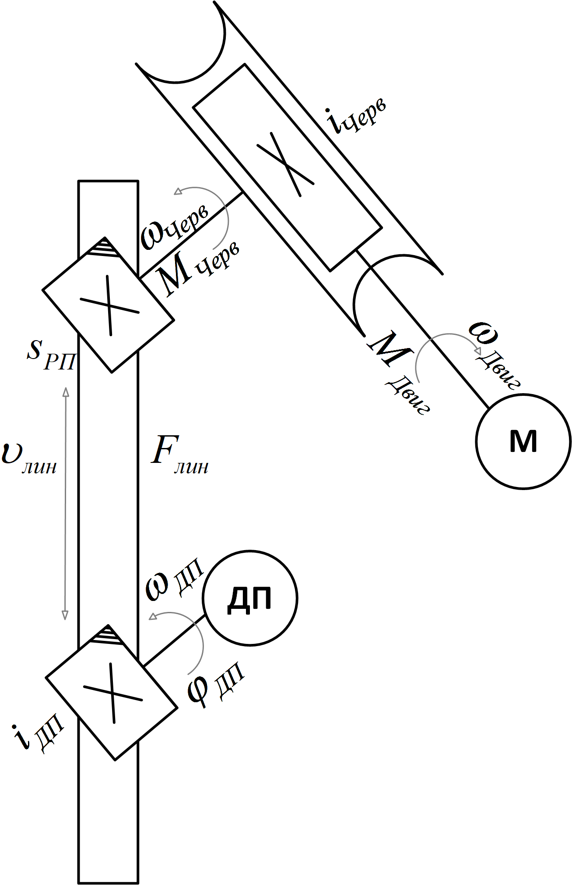
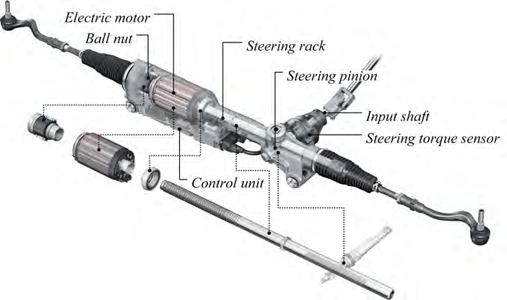
Description of the research object
The control object is a steering rack control unit with an electromechanical power steering. The steering rack is a DC motor that rotates a bevel gear through a worm gear, which participates in rack and pinion transmission, thereby linearly moving the rod of the rack.

Slide 4
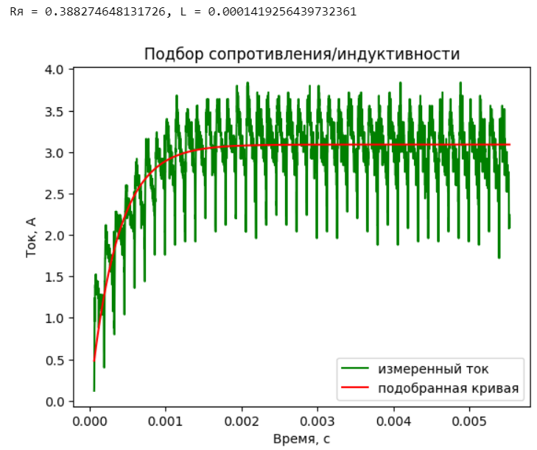
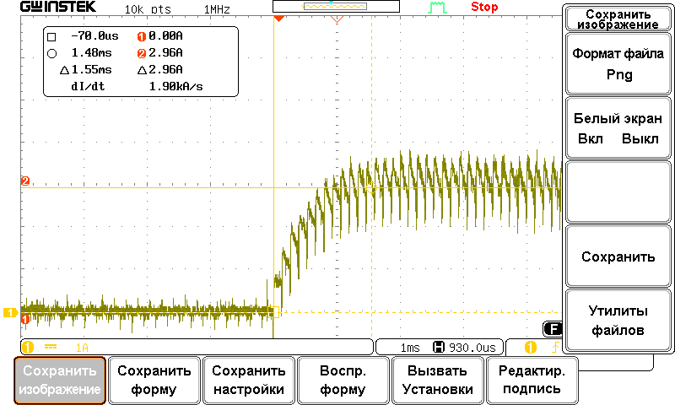
work process

Slide 5
work process
U, V | I, А | V (speed), rpm | w, rad/s | Ri (Winding resistance), Ohm | См (design parameter), V*s/rad
1 | 0,64 | 40 | 4,1887902 | 0,357267 | 0,18414604
2 | 0,67 | 225 | 23,5619449 | 0,357267 | 0,07472351
3 | 0,74 | 400 | 41,887902 | 0,357267 | 0,06530817
4 | 0,79 | 564 | 59,0619419 | 0,357267 | 0,06294678
5 | 0,83 | 745 | 78,0162176 | 0,357267 | 0,06028834
6 | 0,88 | 910 | 95,2949772 | 0,357267 | 0,05966322
7 | 0,94 | 1085 | 113,620934 | 0,357267 | 0,05865265
8 | 0,98 | 1265 | 132,47049 | 0,357267 | 0,05774779
9 | 1,02 | 1450 | 151,843645 | 0,357267 | 0,05687158
10 | 1,08 | 1637 | 171,426239 | 0,357267 | 0,05608331
11 | 1,13 | 1828 | 191,427712 | 0,357267 | 0,05535399
12 | 1,19 | 2018 | 211,324466 | 0,357267 | 0,05477289
13 | 1,28 | 2207 | 231,1165 | 0,357267 | 0,05427003
14 | 1,28 | 2397 | 251,013253 | 0,357267 | 0,05395212
15 | 1,35 | 2575 | 269,653369 | 0,357267 | 0,05383834
16 | 1,42 | 2760 | 289,026524 | 0,357267 | 0,05360297
17 | 1,45 | 2944 | 308,294959 | 0,357267 | 0,05346167
18 | 1,59 | 3145 | 329,34363 | 0,357267 | 0,05292935

Slide 6
work process
U, В | I, А | Measured force, kg | Force, N | Lever length, m | Torque, N * m | Linear Force of the steering rack, N | Design parameter Cм
10 | 15 | 0,5 | 4,9 | 0,146 | 0,7154 | 1433,662 | 0,04769333
10 | 20 | 0,7 | 6,86 | 0,146 | 1,00156 | 2007,126 | 0,050078
10 | 25 | 0,9 | 8,82 | 0,146 | 1,28772 | 2580,591 | 0,0515088
15 | 30 | 1,1 | 10,78 | 0,146 | 1,57388 | 3154,056 | 0,05246267
-10 | 15 | 0,5 | 4,9 | 0,146 | 0,7154 | 1433,662 | 0,04769333
-10 | 20 | 0,7 | 6,86 | 0,146 | 1,00156 | 2007,126 | 0,050078
-15 | 25 | 0,8 | 7,84 | 0,146 | 1,14464 | 2293,859 | 0,0457856
-15 | 30 | 1 | 9,8 | 0,146 | 1,4308 | 2867,323 | 0,04769333
-20 | 35 | 1,3 | 12,74 | 0,146 | 1,86004 | 3727,52 | 0,053144

Slide 7
work process

Slide 8
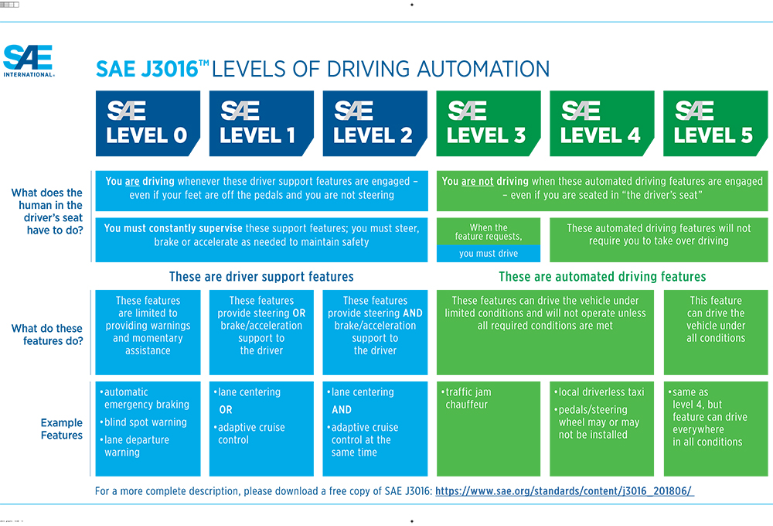
Problem solved in final paper
The main problems of implementing autonomy technologies include the current absence in the Russian Federation of several critical electronic components of the 2nd and 3rd levels [1].
After creating the steering rack electric drive control system and its implementation, we will have a ready-made component that can support the SAE 2+ automation level for any light and light-heavy (up to 3T) car.
[1] — Распоряжение Правительства РФ от 28.12.2022 N 4261-р <Об утверждении Стратегии развития автомобильной промышленности Российской Федерации до 2035 года>

Slide 9


Methods for solving the tasks
There are two ways to get what you don't have: you either
buy it or create it.
Even though creating something is a much longer process, we decided to go this way. Besides, we had time.

Slide 10
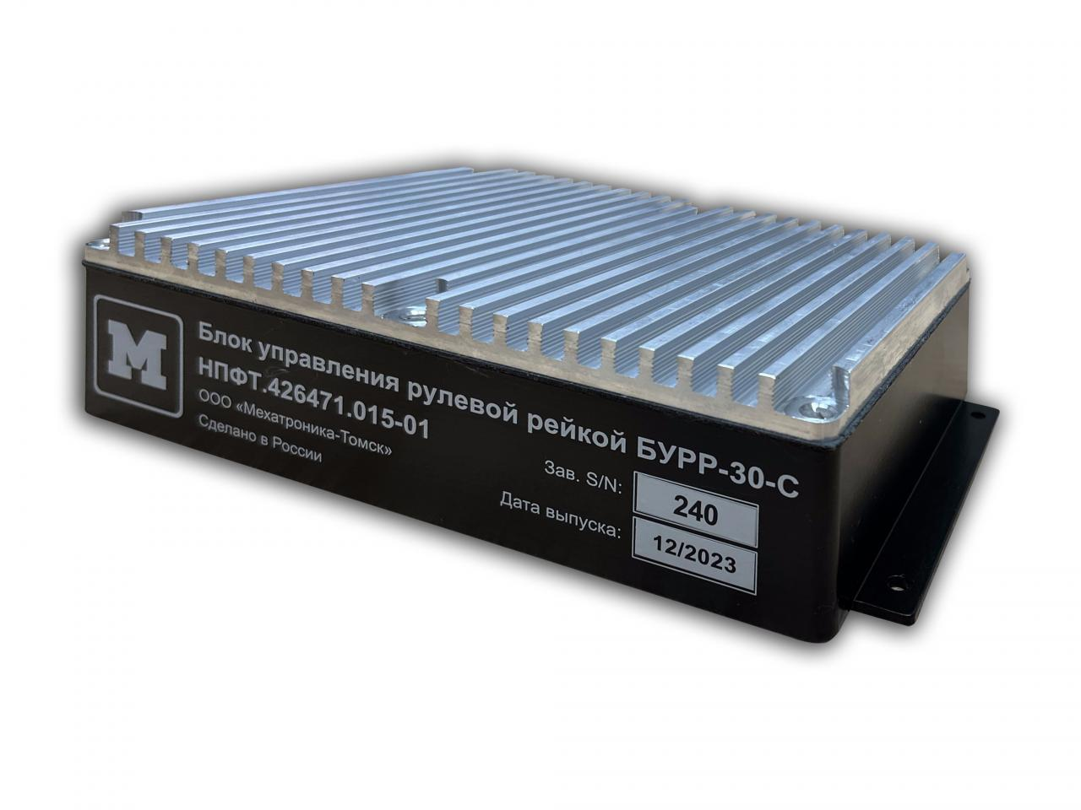
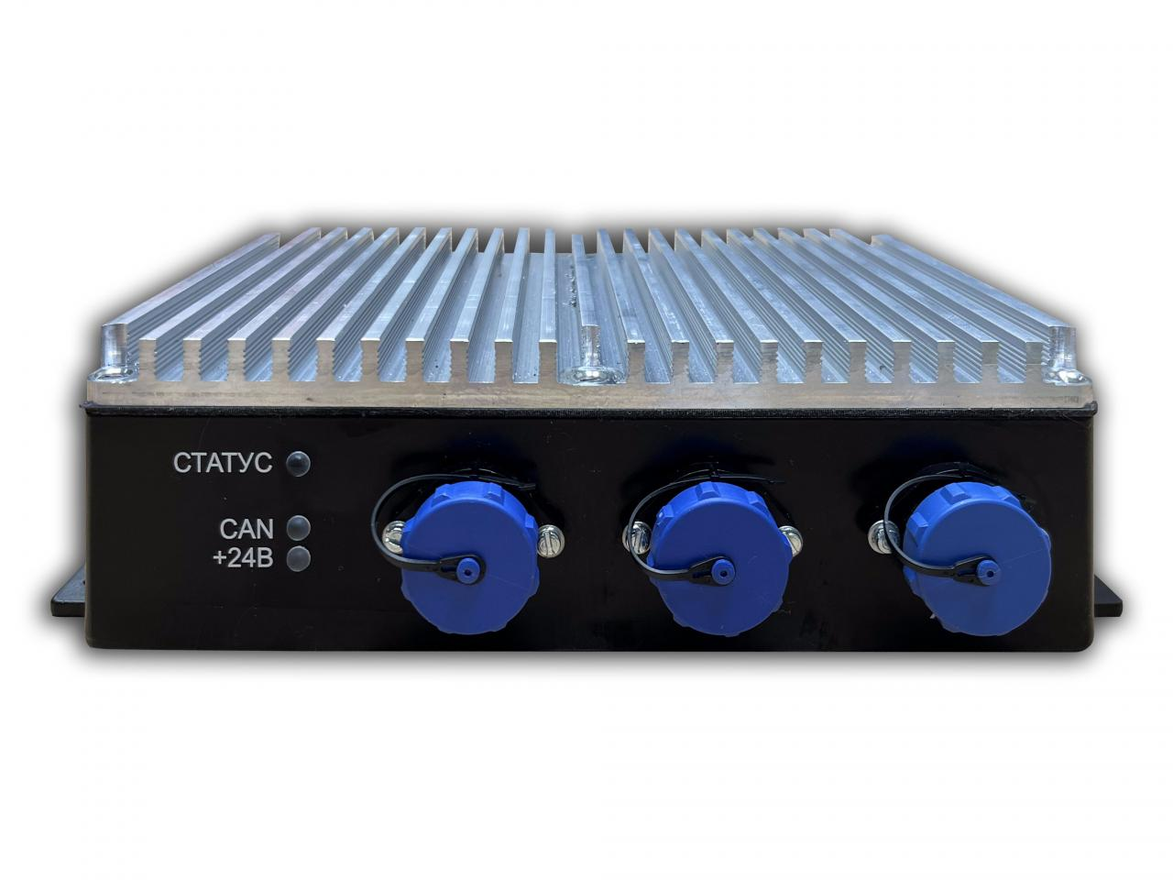
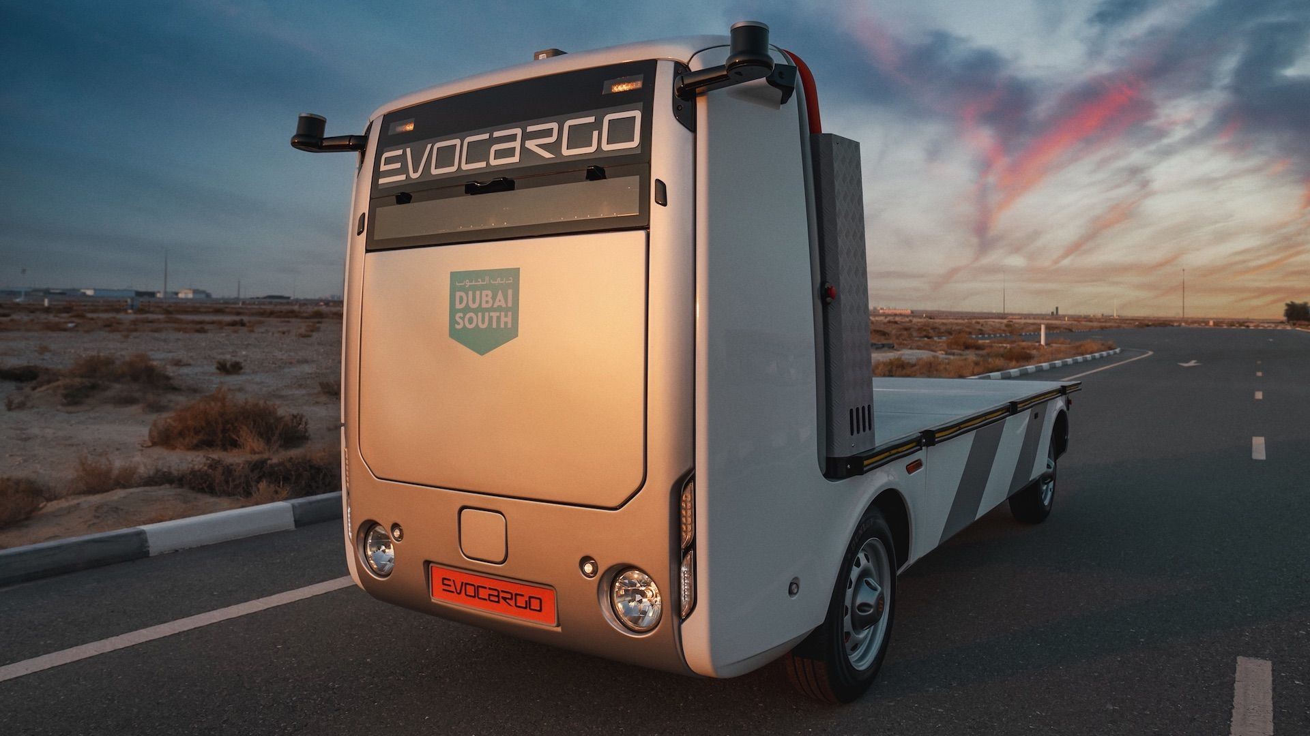
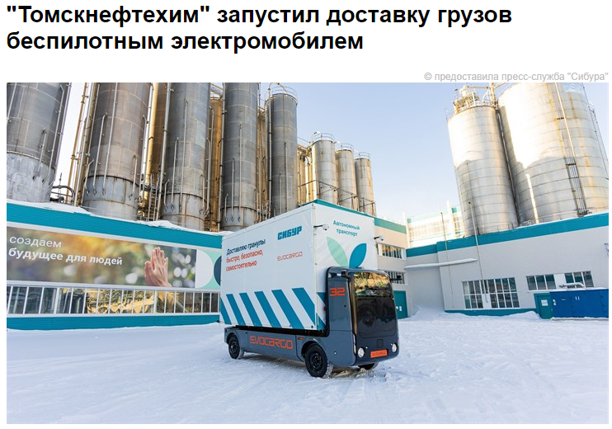
The obtained results of final paper
As a result of the final paper, we received a steering rack control unit, which is now used in autonomous cars both in Russia and abroad.

Slide 11
Development of a steering rack electric drive control system for an autonomous vehicle
Sokurov R., 8E02

